Slide 1
POLS 207 State & Local Government*
Chapter 9C
Legislative Ops: Making Sausage? (Part 1)
Dr. Roblyer, Ph.D.
*These slides are based on originals provided by Dr. Harvey Tucker

Slide 2
Learning Objectives
Describe the different perspectives on the job of at state legislature.
Characterize the number of total bills considered, killed, and passed by a typical legislature in Texas.
Describe the differences in likelihood of success for bills introduces in the Texas House vs. Senate.
Trace the path of a successful bill through the Texas legislative process.
Discuss the differences in success of HBs and SBs within the House and in the Senate internal processes.
Describe how State Rep Rainey’s strategies did not and did succeed in requiring greater accountability from the Blinn College administrators.

Slide 3
Learning Objectives
Walk through the legislative process for a bill, identifying both the uncertainty that exists and who controls the outcome at each step.
Describe what and why of the operations tempo in the Texas Legislature from start to finish with respect to how many bills are on the agenda of the two chambers.
Explain how the Texas Legislature permits “clones” of bills and how these are used to increase the chance of success.

Slide 4
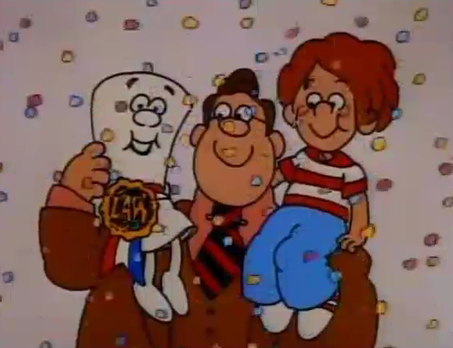
How The Texas Legislature Really Works
Not what you have been taught or believe is true
Typically, the opposite of what you have been taught or believe is true
Remember this…?
http://www.schoolhouserock.tv/
http://www.youtube.com/watch?v=tyeJ55o3El0

Slide 5
Legislature’s Most Important Activity?
News media and textbooks say “passing bills”
News media and textbooks say “weighing legislation”
Members say …
…but only 20-25% pass in a session
…but most bills never even are given a chance!
Dead-on-arrival or
Duplicates that will die
or
Die in committee without thorough consideration

Slide 6
Most Important Activity
News media and textbooks say “passing bills”
News media and textbooks say “considering legislation”
Members say …
Killing bad bills!
Harm their constituents
Waste resources
Ideologically wrong
Since this is their perceived job,
this is also the measure of their
perceived success!

Slide 7
Texas Legislative Workload & Outcome
Democrat-Controlled
R e p u b l I c a n-C o n t r o l l e d
 | 72nd | 73rd | 74th | 75th | 76th | 77th | 78th | 79th | 80th | 81st | 82nd | 83rd
LEGISLATURE | 1991 | 1993 | 1995 | 1997 | 1999 | 2001 | 2003 | 2005 | 2007 | 2009 | 2011 | 2013
Bills Introduced | 4524 | 4380 | 4957 | 5561 | 5766 | 5544 | 5592 | 5484 | 6190 | 7419 | 5796 | 5868
Percent Killed | 79% | 75% | 82% | 74% | 72% | 73% | 76% | 76% | 75% | 81% | 76% | 74%
Pct. Passed by Legislature | 21% | 25% | 18% | 27% | 28% | 29% | 25% | 24% | 25% | 19% | 24% | 26%
Became Law | 20% | 24% | 18% | 26% | 28% | 27% | 24% | 24% | 24% | 19% | 23% | 26%
Legislative Days | 140 | 140 | 140 | 140 | 140 | 140 | 140 | 140 | 140 | 140 | 140 | 140
WHERE BILLS STARTED | 1991 | 1993 | 1995 | 1997 | 1999 | 2001 | 2003 | 2005 | 2007 | 2009 | 2011 | 2013
House Bills | 64% | 66% | 65% | 65% | 67% | 67% | 69% | 65% | 67% | 65% | 67% | 67%
Senate Bills | 36% | 34% | 35% | 35% | 33% | 55% | 35% | 35% | 33% | 35% | 33% | 33%

Slide 8
The Legislative Process in the States
Chamber of Origin | Second Chamber | Conference Committee
Bill is drafted
Introduction and First Reading | Introduction and First Reading | Committee members chosen
Committee referral | Committee referral | Bill redrafted and sent to both chambers
Subcommittee | Subcommittee | If both chambers approve, sent to governor
Committee hearings | Committee hearings
Committee Action | Committee Action
Calendar placement | Calendar placement
Second Reading and floor consideration | Second Reading and floor consideration
Third Reading and floor vote | Third reading and floor vote
Reconsideration | Reconsideration
Sent to opposite chamber | If amended, returned to chamber of origin
 | If approved without amendment, sent to governor

Slide 9
Texas Legislature: Bill Flow, Mortality, and Success
HOUSE BILLS | 1991 | 1993 | 1995 | 1997 | 1999 | 2001 | 2003 | 2005 | 2007 | 2009 | 2011 | 2013
HB deliberated in House | 68% | 63% | 68% | 69% | 80% | 78% | 73% | 75% | 72% | 74% | 70% | 70%
HB pass House committee | 44% | 40% | 40% | 43% | 43% | 48% | 44% | 47% | 46% | 44% | 45% | 44%
HB pass House | 27% | 31% | 26% | 29% | 32% | 35% | 31% | 33% | 32% | 27% | 28% | 25%
HB deliberated in Senate | 24% | 27% | 23% | 27% | 29% | 31% | 25% | 28% | 27% | 22% | 23% | 21%
HB pass Senate committee | 22% | 25% | 21% | 25% | 26% | 28% | 24% | 27% | 26% | 21% | 22% | 19%
HB pass legislature | 18% | 22% | 19% | 24% | 24% | 27% | 23% | 24% | 23% | 18% | 21% | 19%
HB enacted law | 17% | 22% | 18% | 24% | 24% | 25% | 22% | 24% | 22% | 18% | 20% | 18%
SENATE BILLS | 1991 | 1993 | 1995 | 1997 | 1999 | 2001 | 2003 | 2005 | 2007 | 2009 | 2011 | 2013
SB deliberated in Senate | 68% | 66% | 61% | 64% | 71% | 69% | 62% | 63% | 67% | 64% | 63% | 69%
SB Pass committee Senate | 53% | 52% | 50% | 54% | 58% | 56% | 50% | 53% | 52% | 53% | 51% | 55%
SB Pass Senate | 45% | 46% | 44% | 48% | 52% | 51% | 43% | 46% | 48% | 46% | 46% | 50%
SB Deliberated in House | 39% | 41% | 40% | 44% | 46% | 46% | 39% | 40% | 43% | 41% | 42% | 46%
SB pass House committee | 38% | 39% | 38% | 41% | 42% | 43% | 37% | 38% | 40% | 38% | 40% | 44%
SB pass legislature | 27% | 30% | 29% | 32% | 35% | 33% | 29% | 27% | 26% | 23% | 30% | 37%
SB enacted law | 26% | 29% | 28% | 31% | 34% | 32% | 28% | 27% | 25% | 22% | 30% | 36%

Slide 10
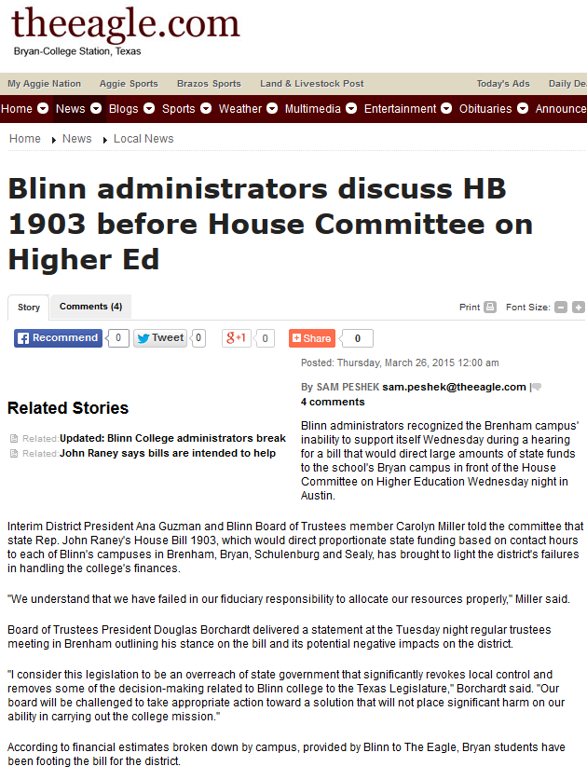
http://www.theeagle.com/news/local/blinn-administrators-discuss-hb-before-house-committee-on-higher-ed/article_09dde480-0a21-580d-8d71-d980134eb580.html
HB 1903 would not become law, but Rep Rainey did secure 2 key changes to law affecting Bryan’s Blinn College campus:
Amendment to HB 1 (Biennial Budget) that required junior college systems to account for spending campus-by-campus, to highlight any disparities
HB 2621 required that 2 members of the Board of Trustees for Blinn College be from Brazos County

Slide 11
At every step, there is uncertainty…
One or more legislators must sponsor and introduce the bill
Sponsors can be hard to find, are not equal in clout or success record
The sponsor(s) may only want to assuage the constituents, not fight for its passage
All bills are assigned to a committee, but…
Many bills are never deliberated (discussed)
Many bills are never approved by their committee
Bills that come out of committee are then assigned to a “calendar” based on content and priority, but…
Different calendars have different rules about amendments, debate, etc.
Bills that are voted on in a chamber may not pass
Bills must pass BOTH the initial floor vote AND reconsideration
Bills that pass in one chamber must repeat the entire process in the other chamber
Bills that are passed by both chambers must be exactly alike, or a “conference” must try to find a compromise and resubmit the revised bill to both chambers for approval
ONLY THEN will the bill go to the governor for veto or signature

Slide 12
…and politics is often the reason for the uncertainty!
The Speaker (House) and Lt Governor (Senate) can bless or curse a bill, depending on whether they like it or not
They may bestow a special low number to any bill to signal a top priority
They may assign a bill to an “easy” committee if they want the bill to come to a vote
They may assign a bill to an “impossible” committee if they want to kill the bill
They may assign a bill they like that comes out of committee to a prime calendar spot where the bill is likely to be debated and passed
They may assign a bill they dislike that somehow comes out of committee to a “do nothing” spot on the chamber calendar so that it will not be debated or voted on
They can use various techniques to limit or influence debate of a bill on the floor
Since successful bills must pass in both chambers, both the Speaker and the Lt Governor must support the bill
The governor must also support the bill, or at least be unwilling to veto it, in order for the bill to become law

Slide 13
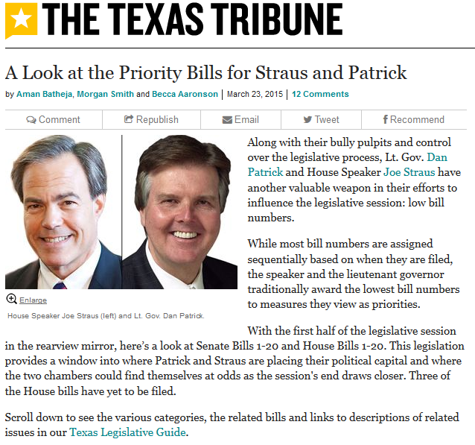
http://www.texastribune.org/2015/03/23/patrick-and-straus-top-20-priority-bills/

Slide 14
Rhythm of the Texas Legislature: Traffic Jams & Fights to the Finish
3000
Last week before 60th day
https://twitter.com/hashtag/txlege?src=hash&ref_src=twsrc%5Etfw
1500
Rule change on Day 60: 80% consent required to introduce new bills (except local & emergency bills)
Most bills may only be deliberated
Final 2 weeks
5.5 bills passed/day
19.5 killed/day
46 passed/day
46 killed/day
50% of all bills passed!!!

Slide 15
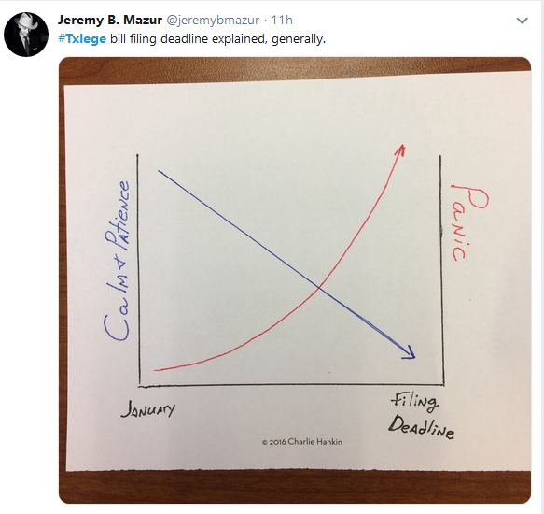
Rhythm of the Texas Legislature: Traffic Jams & Fights to the Finish
3000
Last week before 60th day
1500
Rule change on Day 60: 80% consent required to introduce new bills (except local & emergency bills)
https://twitter.com/hashtag/txlege?src=hash&ref_src=twsrc%5Etfw
Most bills may only be deliberated
Final 2 weeks
5.5 bills passed/day
19.5 killed/day
46 passed/day
46 killed/day
50% of all bills passed!!!

Slide 16
Common strategy to improve the odds of getting a bill through…
Individual bills are not often successful
Instead, original bills often augmented with “identical” bills:
Duplicate bill – copy of a bill introduced in the same chamber
Companion bill – copy of a bill introduced in the other chamber
BEST plan for success is to introduce companion bills into the House and Senate
Why?
Increase chances of passage, although only one can survive!
Shares success between authors of original bill and each identical bill!

Slide 17
Use of identical bills and measuring success in the Texas Legislature
Traditional success measure: Passage of an individual bill
Legislators’ success measure: Passage of a bill or any identical bill (especially if not amended!)
Example:
HB 672 in 2011 by Christian filed Jan 14, 2012. Referred to Economic and Small Business Development Committee on Feb 21 and dies without committee deliberation
HB1050 duplicate by Woolley filed Feb 2, 2011 referred to Economic and Small Business Development Committee Feb 28. Hearing on Mar 17, passed March 24, placed on General State Calendar April 14. SB 458 substituted on April 14, so HB 1050 dies.
SB 458 identical companion by Seliger filed Jan 31; referred to Economic Development Committee Feb 14. Passed by committee March 14. Passed Senate floor March 24.
House Bill
Senate Bill

Slide 18
Practice Problems …to begin mastering this material. Complete instructions are in the Module 1 resource, How to Use Practice Problems to Prepare for Exams.
Don’t forget to do the…

